Slide 1
Secure Browser

Slide 2
Steps to enable cookies in Google Chrome:
1 - Open Chrome preferences click on Settings, then Show Advanced Settings
2 - Under Privacy, click on Content Settings
3 - Make sure "Block third-party cookies and site data" is not checked
4 - Keep all the toggle heads as - "Allow"
5 - Problem still persist, please ask for screenshot, if possible, which will help in addressing to our tech team

Slide 4
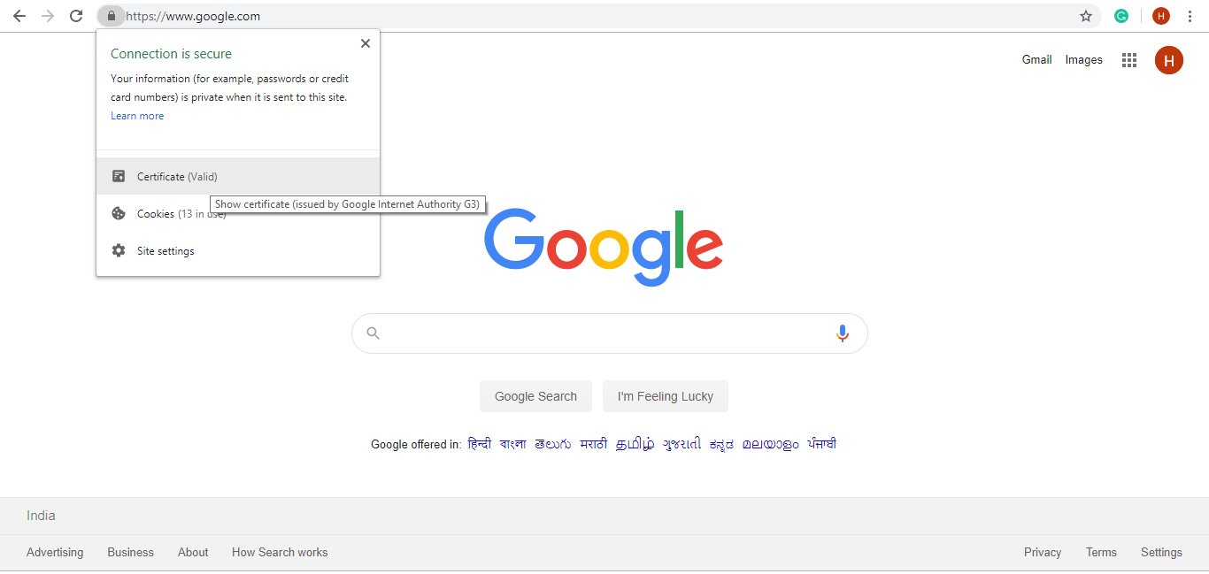

Slide 5
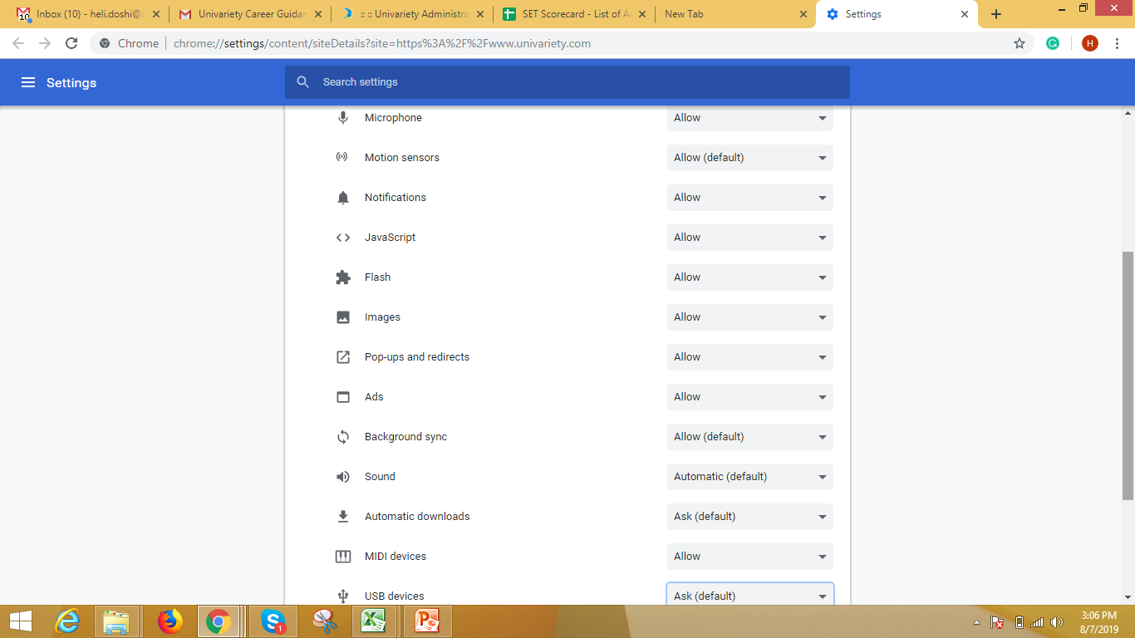
Select – Allow on all the toggle button

Slide 6
Clear Cookies

Slide 7
Steps to clear cookies in Google Chrome:
Open Chrome preferences click on Settings, then Show Advanced Settings
At the top right, click More
Click More tools - Clear browsing data
At the top, choose a time range to delete everything, select ”All time”
Next to "Cookies and other site data" and "Cached images and files," check the boxes
Click Clear data

Slide 9
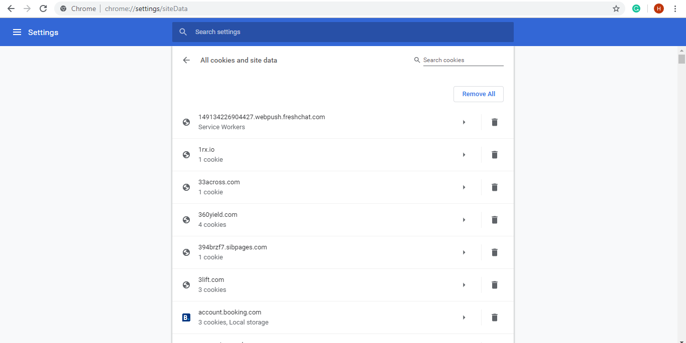

Slide 10
