Slide 1
e-Suvidha Implementation 2013-14
Pre-Admission Online Registration
Process for Student

Slide 2
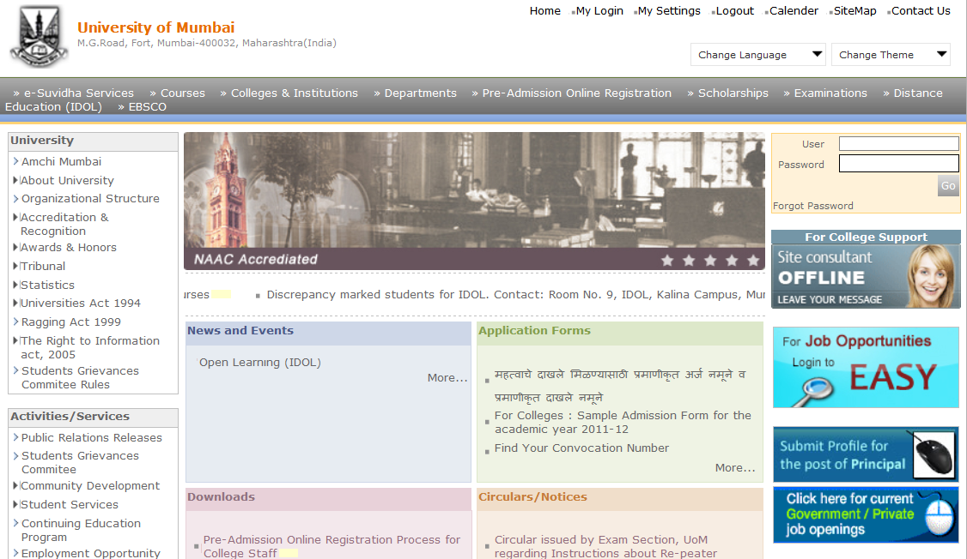
Visit on mum.digitaluniverisity.ac & Apply for Online Admission
Click on ‘Pre-Admission Online Registration’

Slide 3
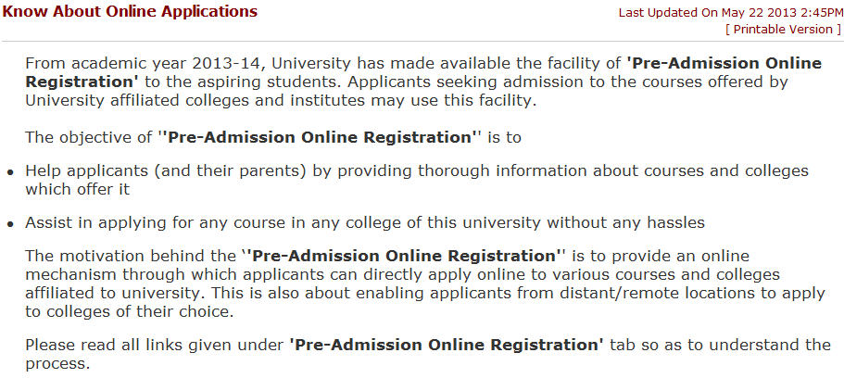
Know About Online Admissions

Slide 4
What all do you need to apply?

Slide 5
Who Can Apply?

Slide 6
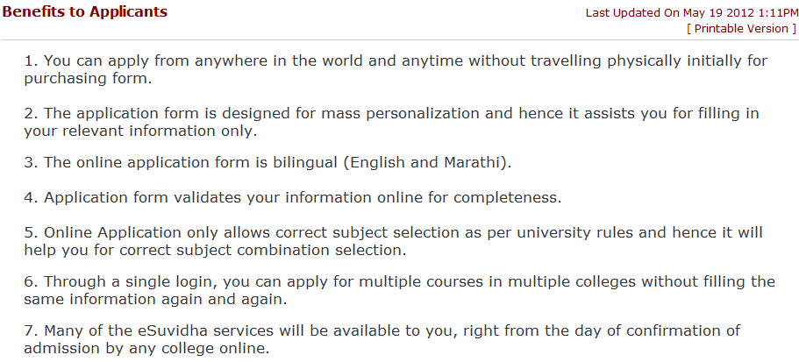
Benefits to Applicants

Slide 7
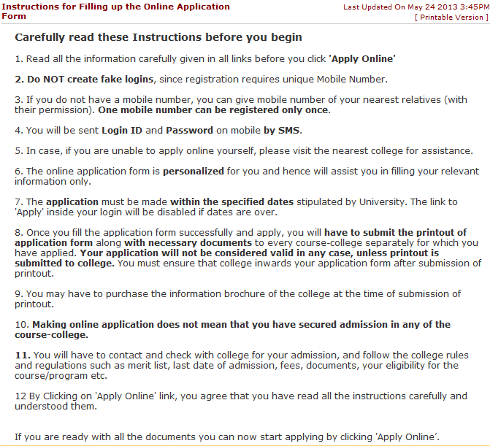
Instructions for Filling up the Online Application Form

Slide 8
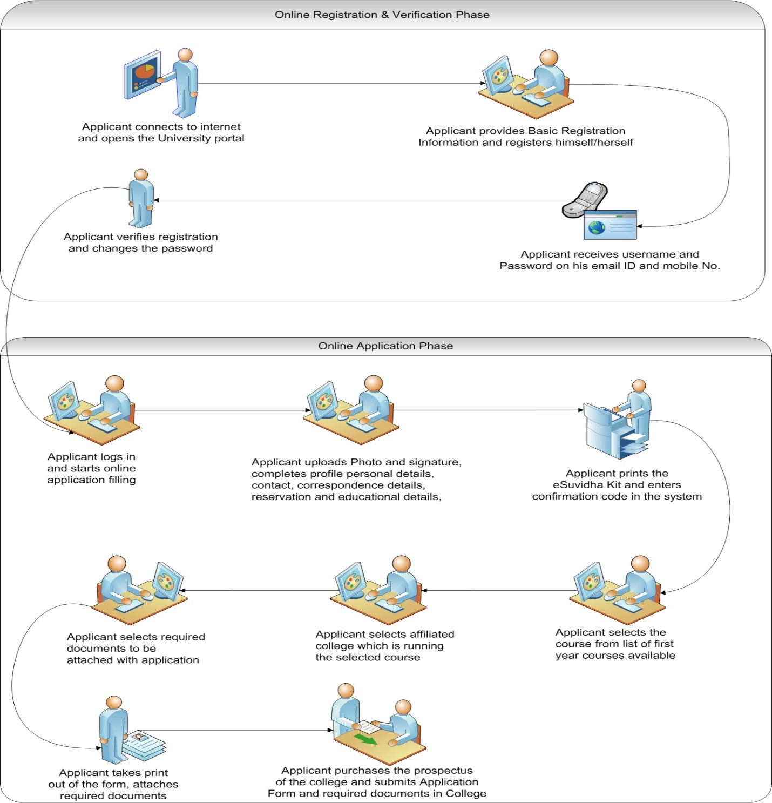
Application process flow

Slide 9
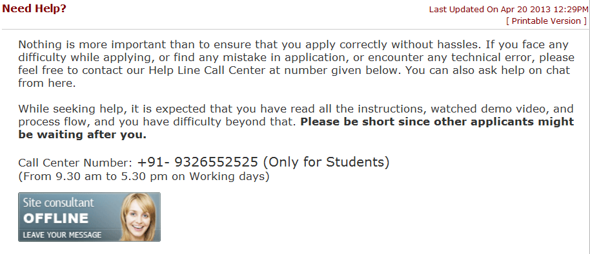
Need Help?

Slide 10
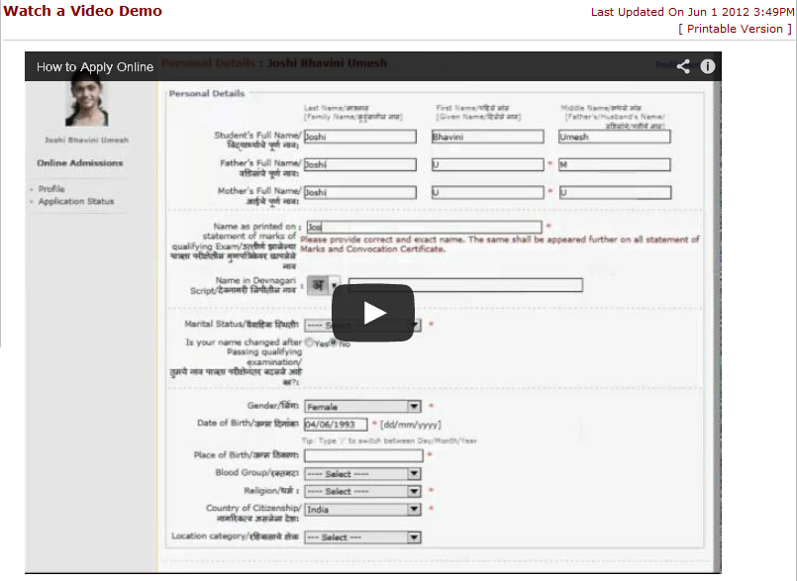
Watch a Video Demo

Slide 11
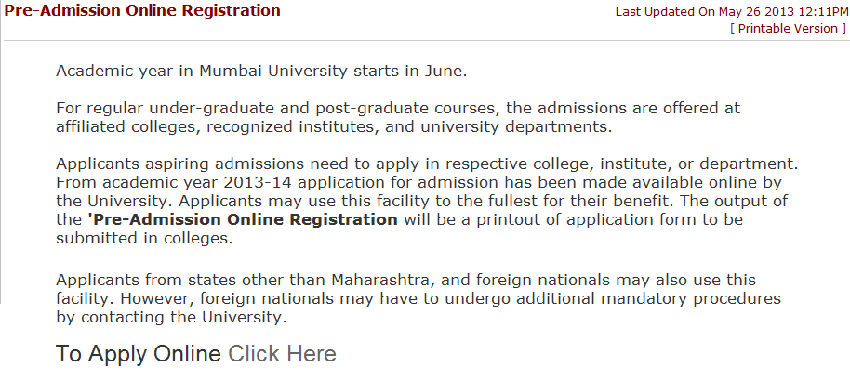
Apply online for Online Application
Click on Apply Online

Slide 12
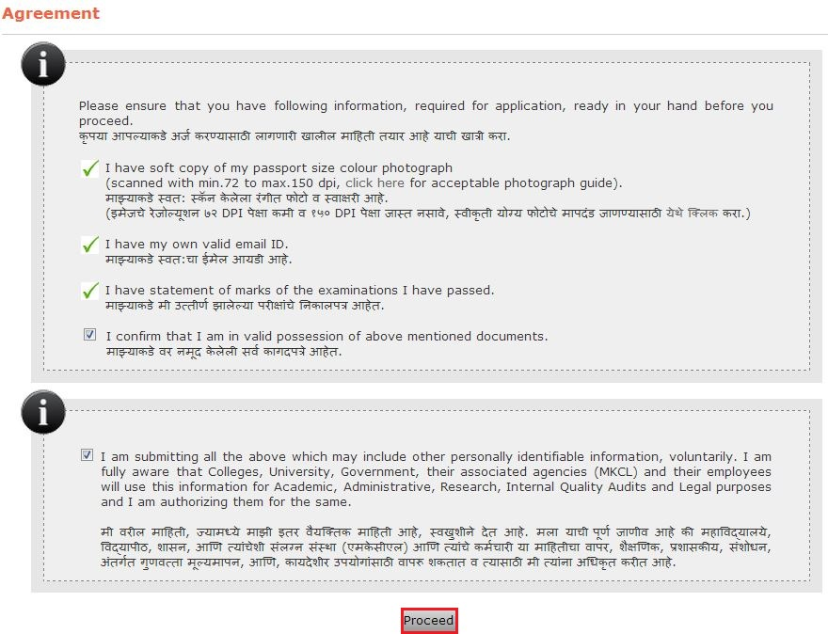
Agreement
After carefully read & understood click on Proceed

Slide 13
Registration Information
Click on Proceed

Slide 14
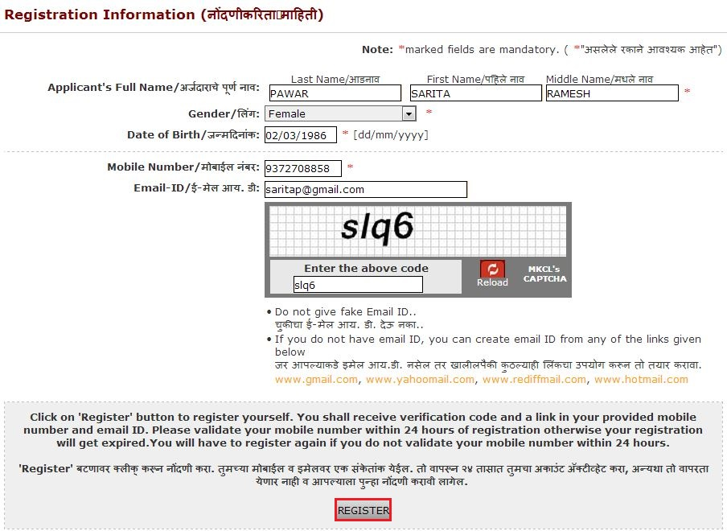
Registration Information
Click on Register

Slide 15
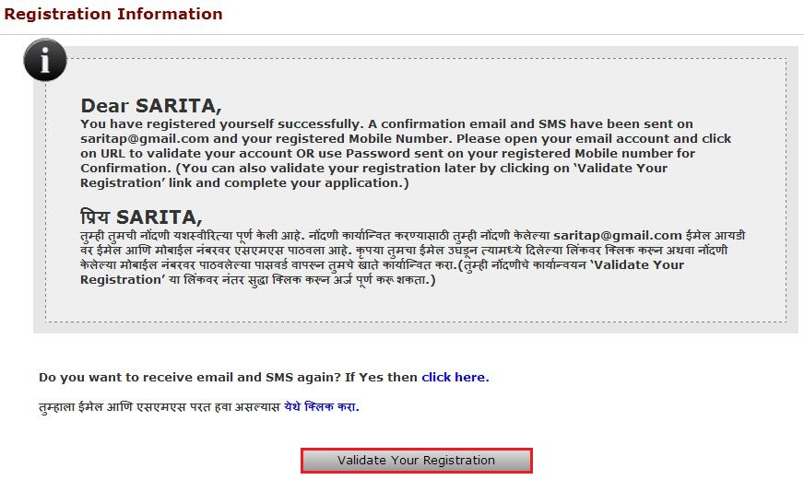
Registration Information
Click on Validate your Registration

Slide 16
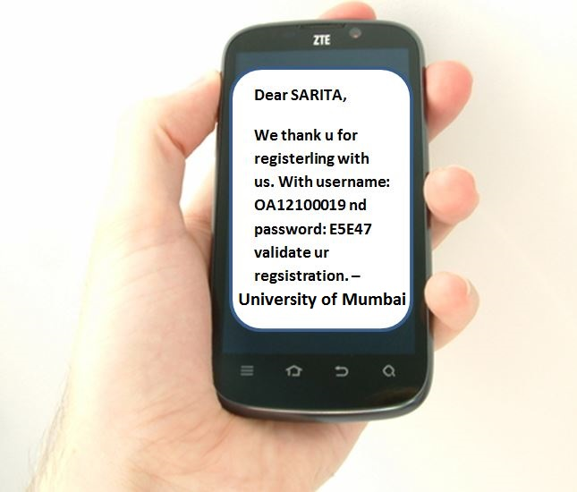
Login Detail via SMS

Slide 17
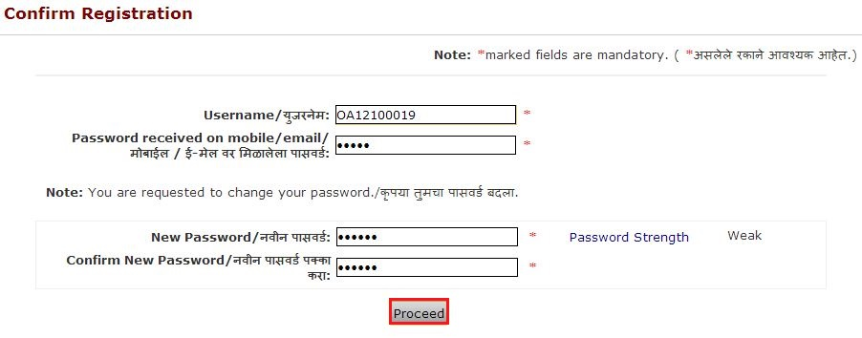
Login Detail via SMS
Click on Proceed

Slide 18
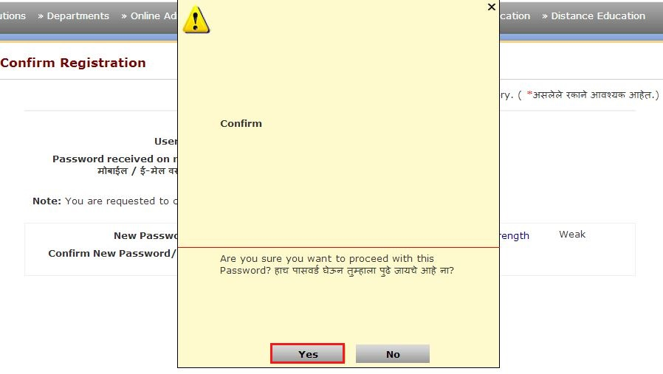
Confirmation about changed password
Click on Yes

Slide 19
Login with New Password
Click on Go

Slide 20
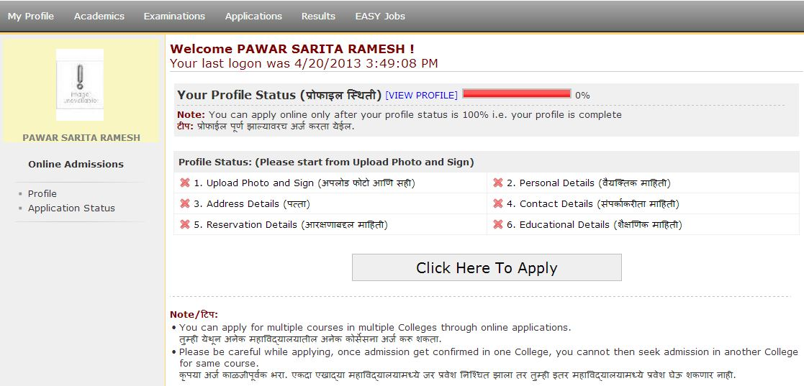
Update Profile
Check Profile Status

Slide 21
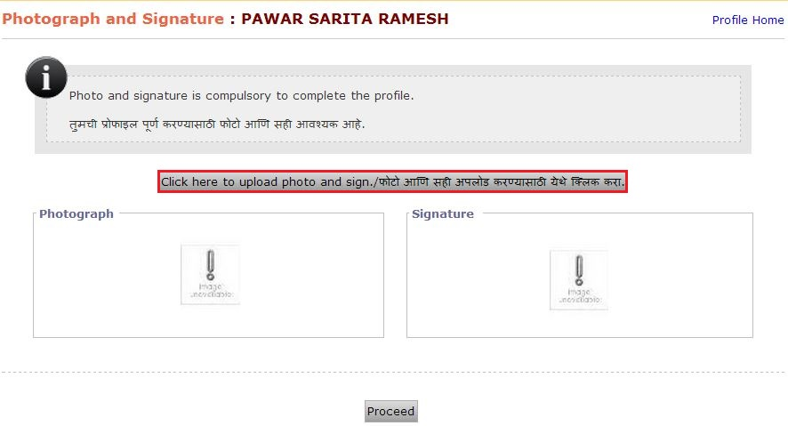
Upload Profile
Click here to upload photo & sign
Note: You have scanned images of Photos & Signs in
.jpge format

Slide 22
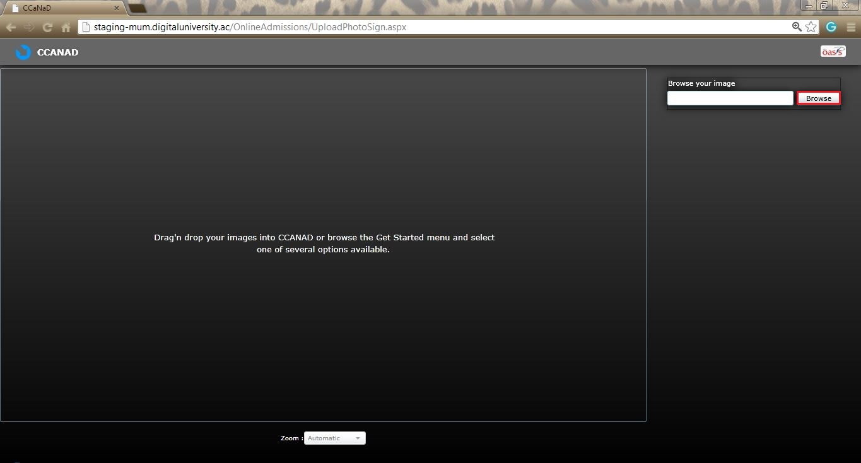
Use CCaNaD software for cropping & uploading the photo & sign in proper format.
Click on Browse

Slide 23
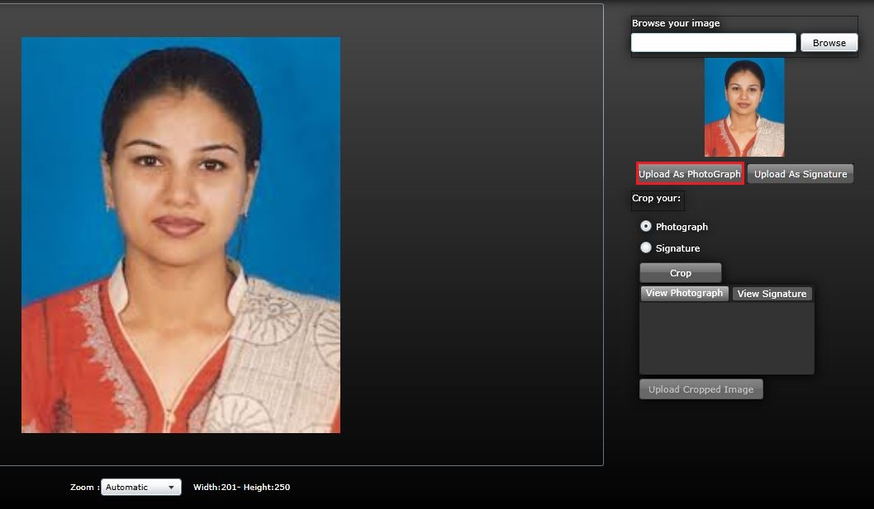
Upload Photograph
Click on Upload As Photograph

Slide 24
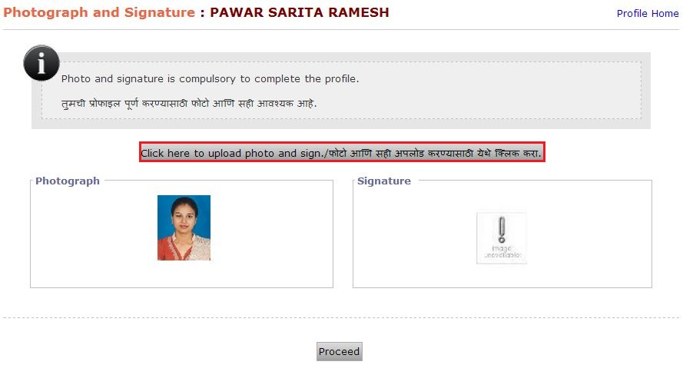
Verify Uploaded Photograph

Slide 25
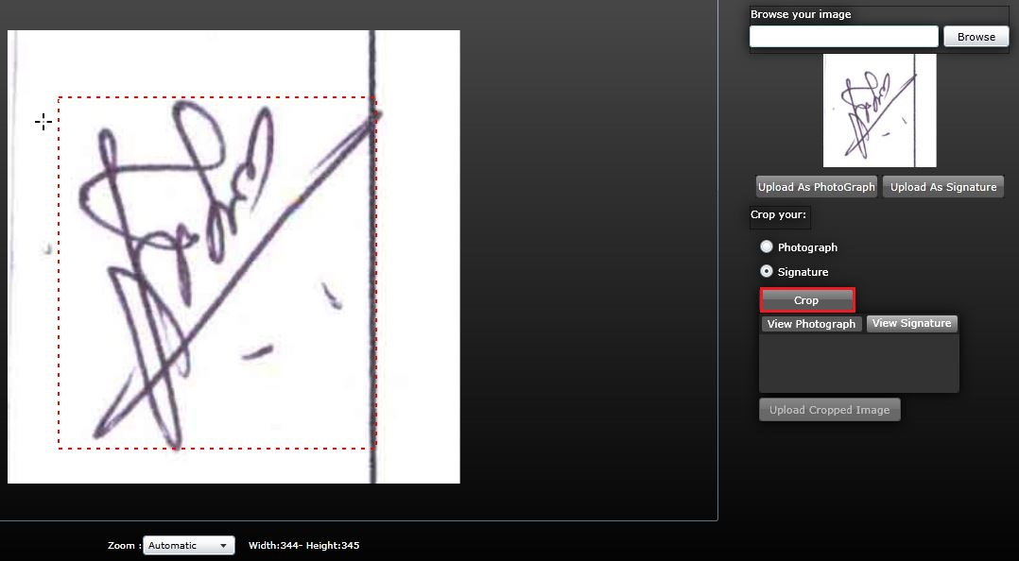
Crop Signature
After select image click on crop
Select sign image

Slide 26
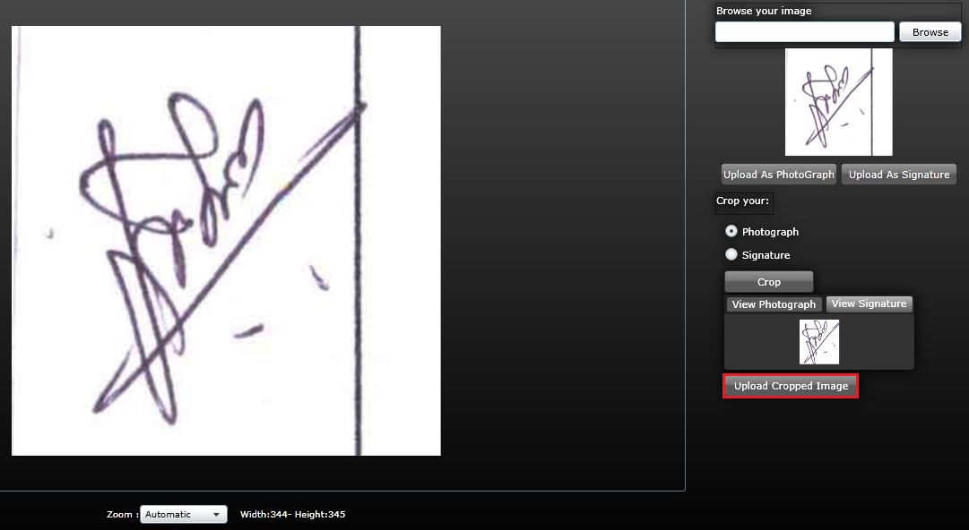
Upload Cropped Signature
Click on Upload Cropped Image

Slide 27
Uploading Cropped Image

Slide 28
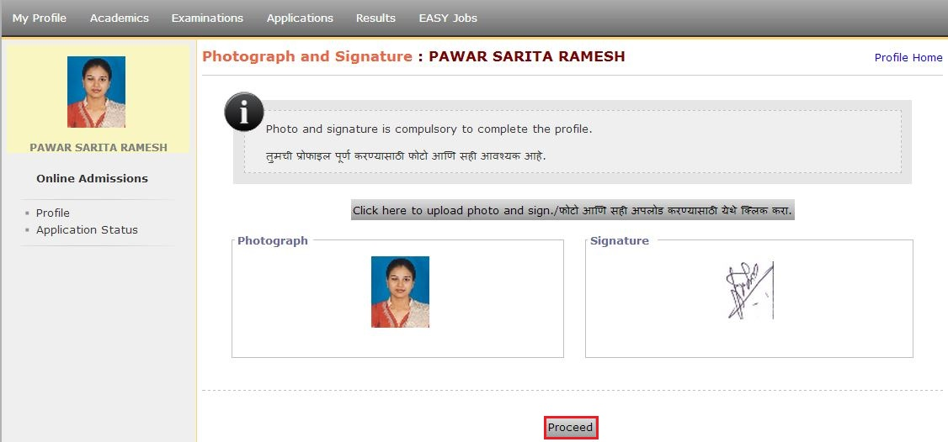
Verify Uploaded Sign
After verification click on Proceed

Slide 29
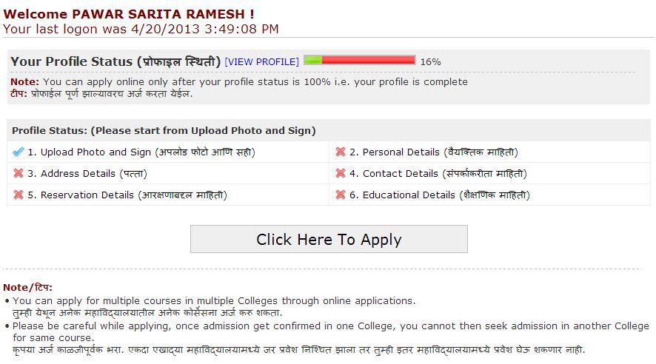
Personal Details
Click on Personal Details

Slide 30
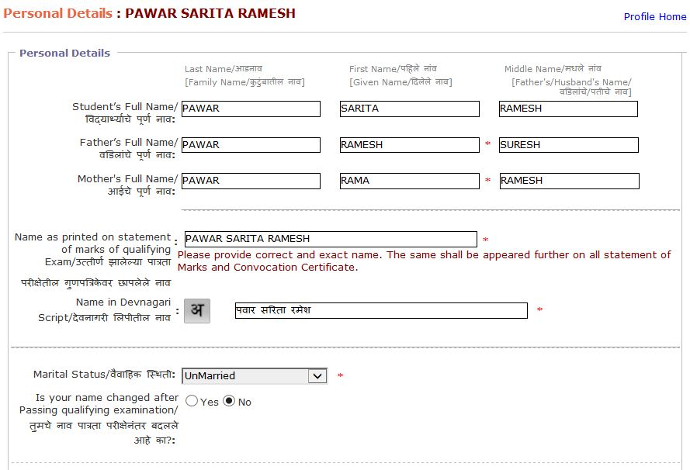
Enter Personal Details

Slide 31
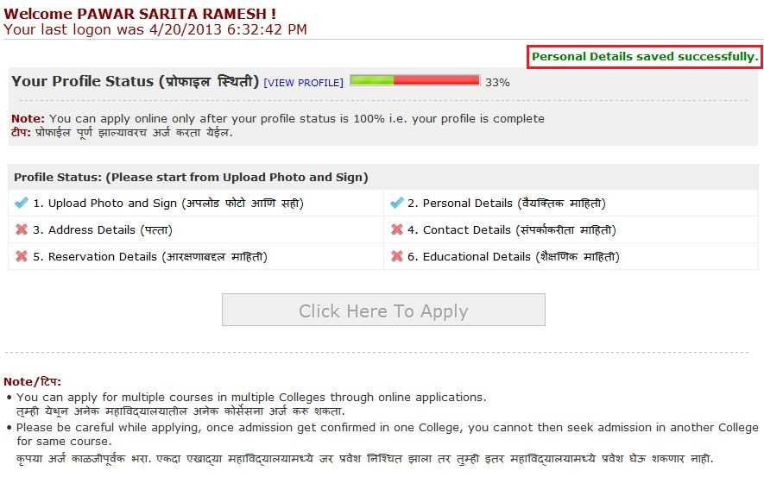
Enter Address Details
Click on Address Details

Slide 32
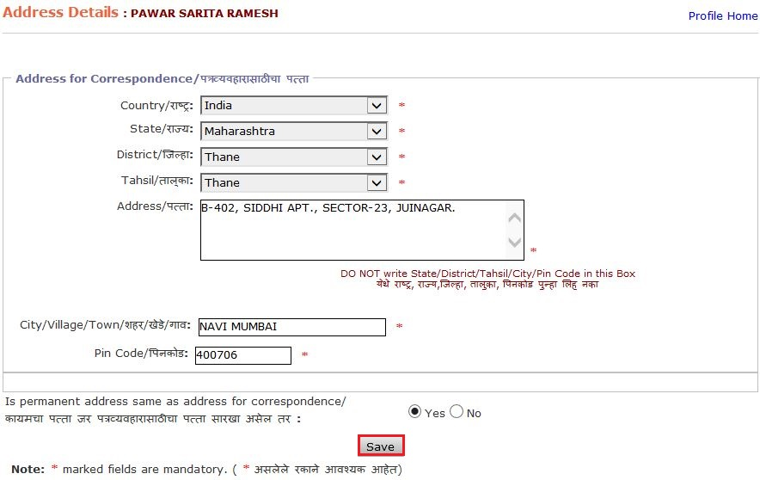
Enter Address Details
Click on Save

Slide 33
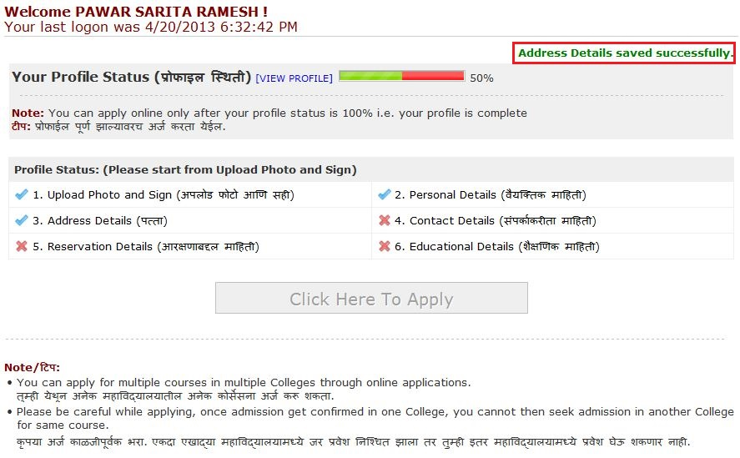
Enter Contact Details
Click on Contact Details

Slide 34
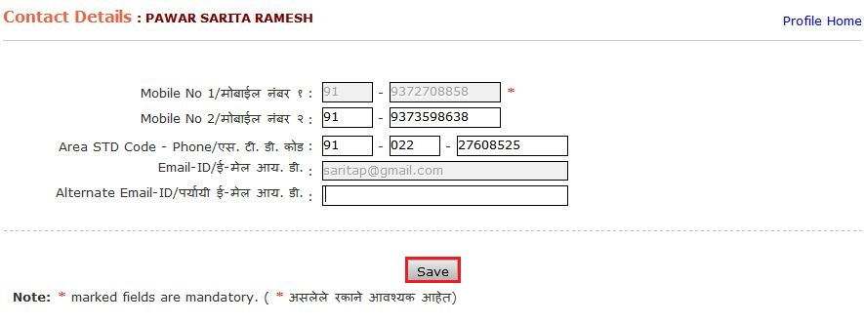
Enter Contact Details
Click on Save

Slide 35
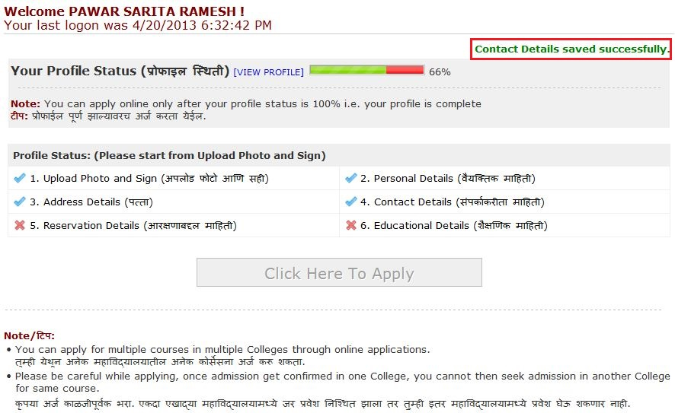
Enter Reservation Details
Click on Reservation Details

Slide 36
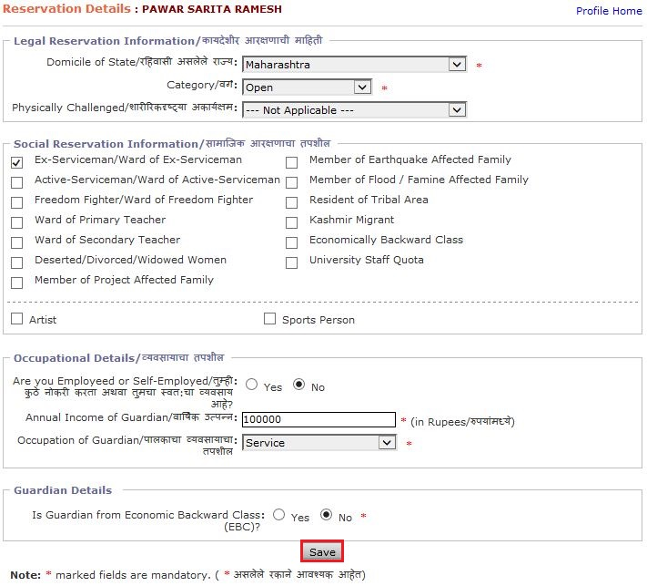
Enter Reservation Details
Click on Save

Slide 37
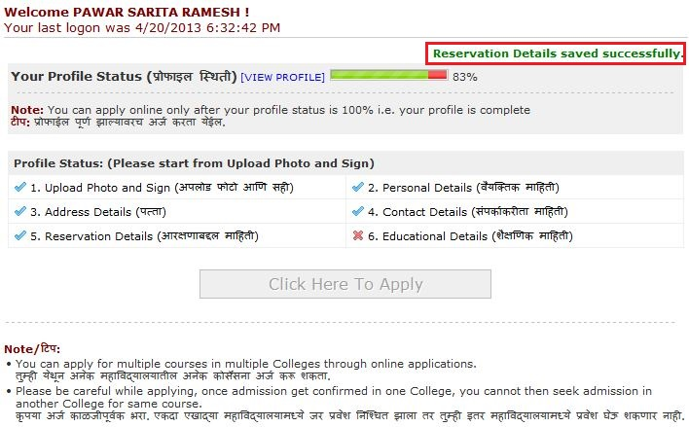
Enter Educational Details
Click on Educational Details

Slide 38
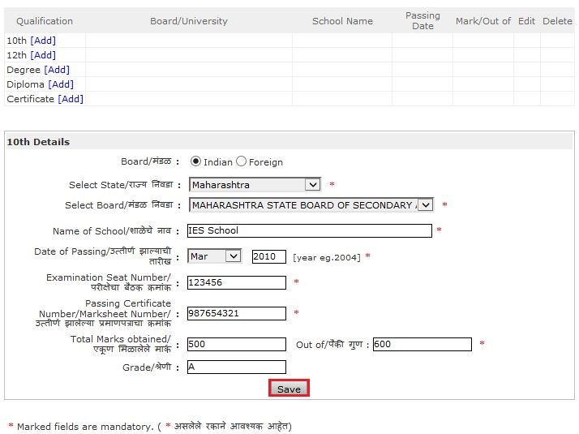
Enter Educational Details
Click on Save

Slide 39
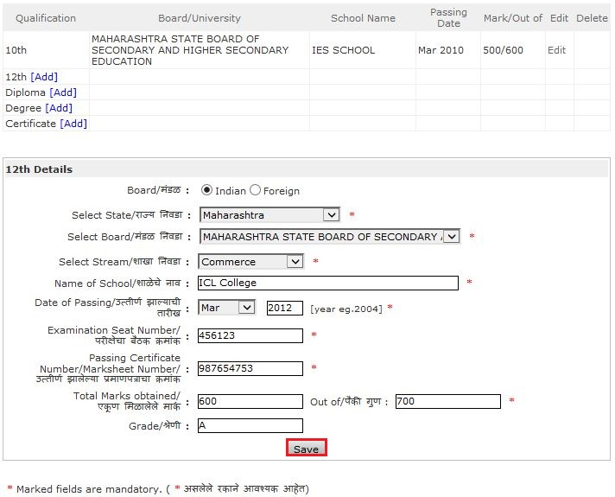
Enter Educational Details
Click on Save

Slide 40
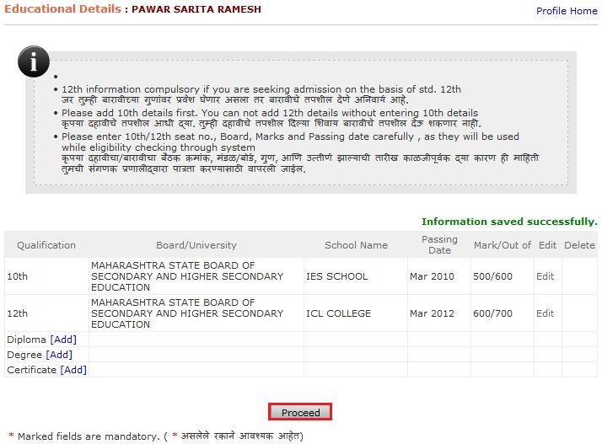
Enter Educational Details
Click on Proceed

Slide 41
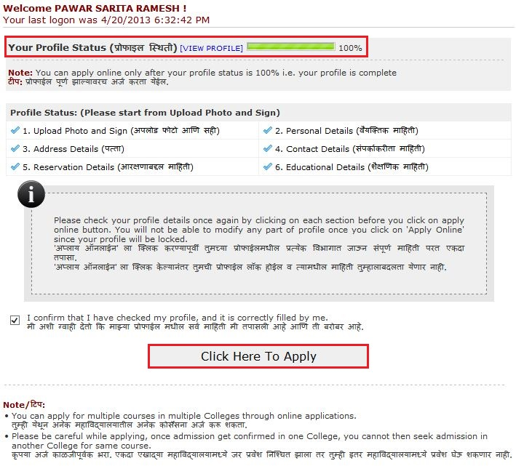
Profile Status
Click here to Apply

Slide 42
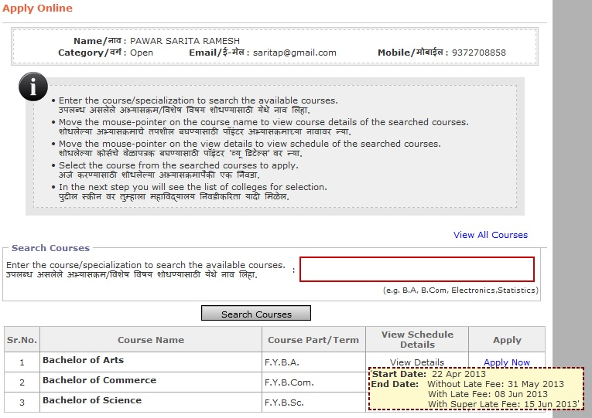
Course wise Schedule Details
View Schedule Details

Slide 43
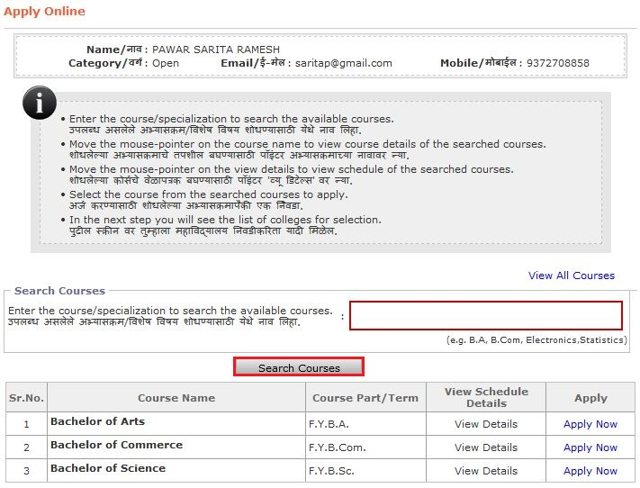
Course Selection
Click on Search Courses

Slide 44
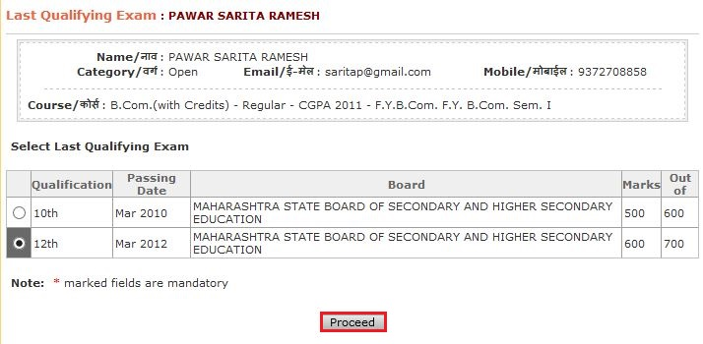
Select Last Qualifying Exam
Click on Proceed

Slide 45
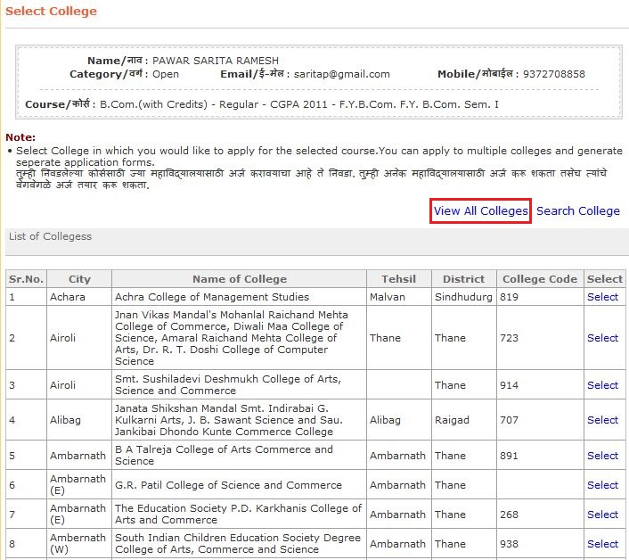
View College List

Slide 46
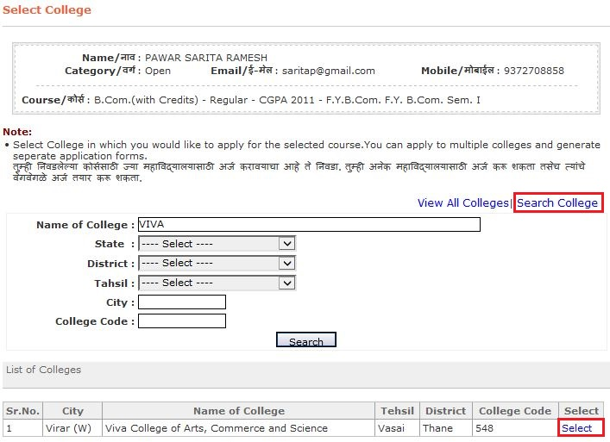
Select College
Click here for Search College
Select College

Slide 47
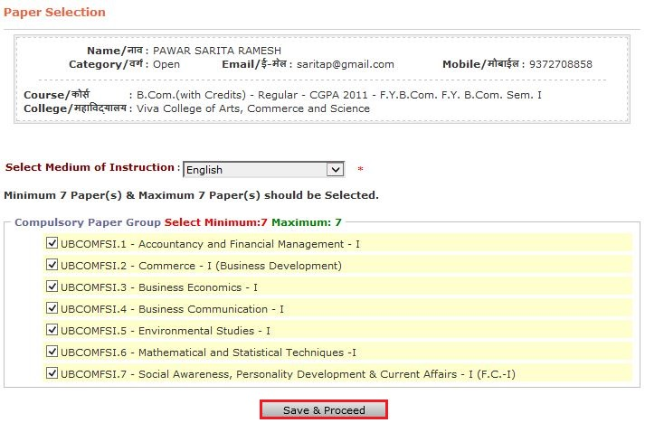
Select Medium & Appearing Papers
Click on Save & Proceed

Slide 48
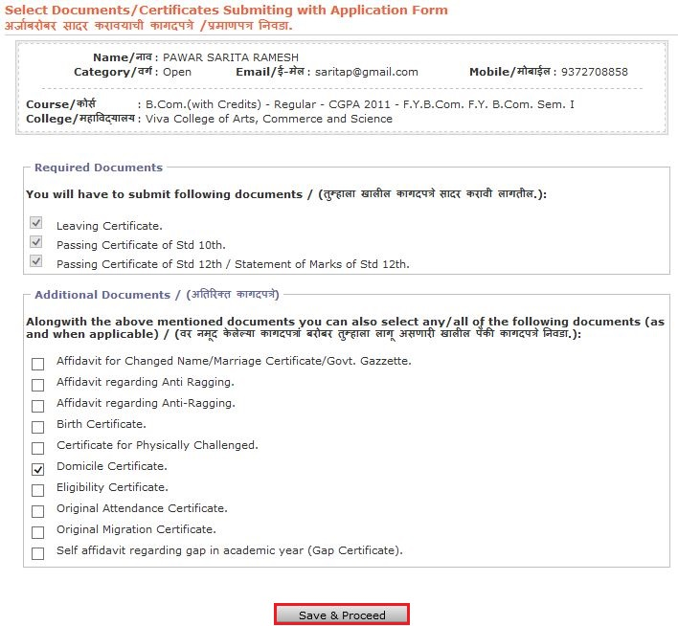
Submitting Document with Application Form
Click on Save & Proceed

Slide 49
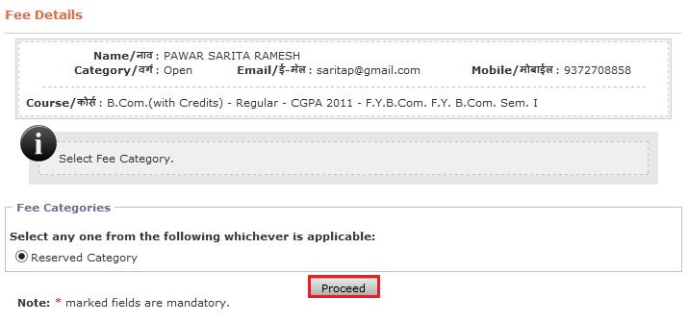
Fees Details
Click on Proceed

Slide 50
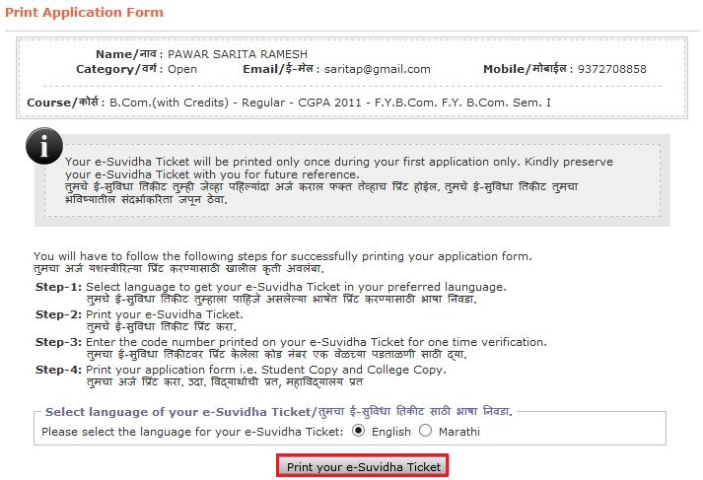
Print e-Suvidha Ticket
Click on Print e-Suvidha Ticket

Slide 51
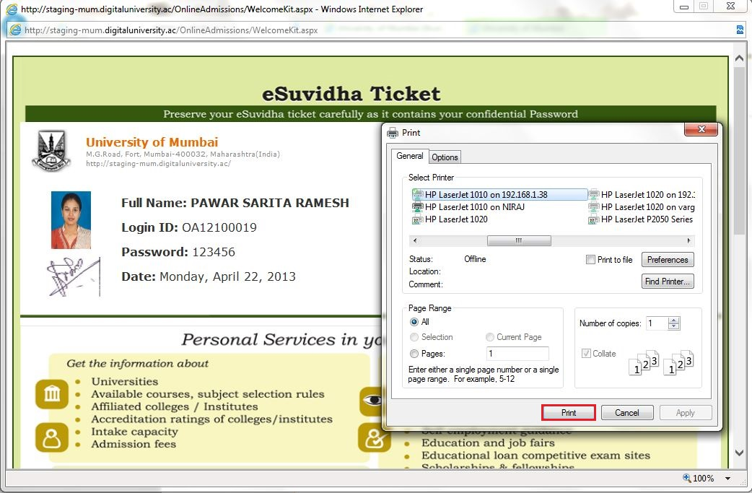
Print e-Suvidha Ticket
Click on Print

Slide 52
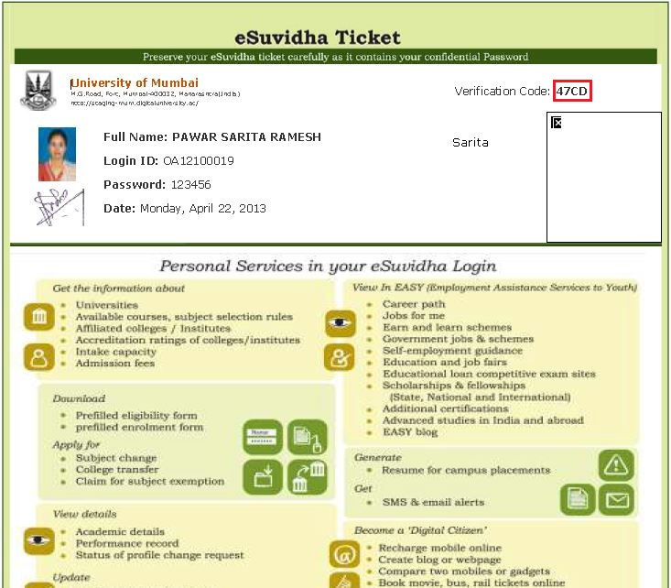
e-Suvidha Ticket: Verification Code
Verification Code

Slide 53
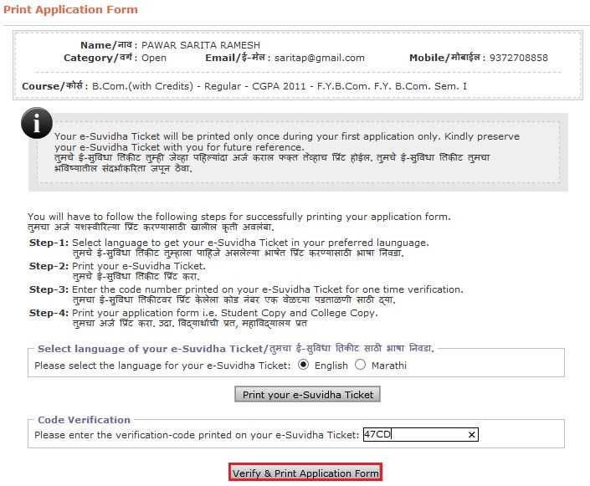
Print Application Form
Click here

Slide 54
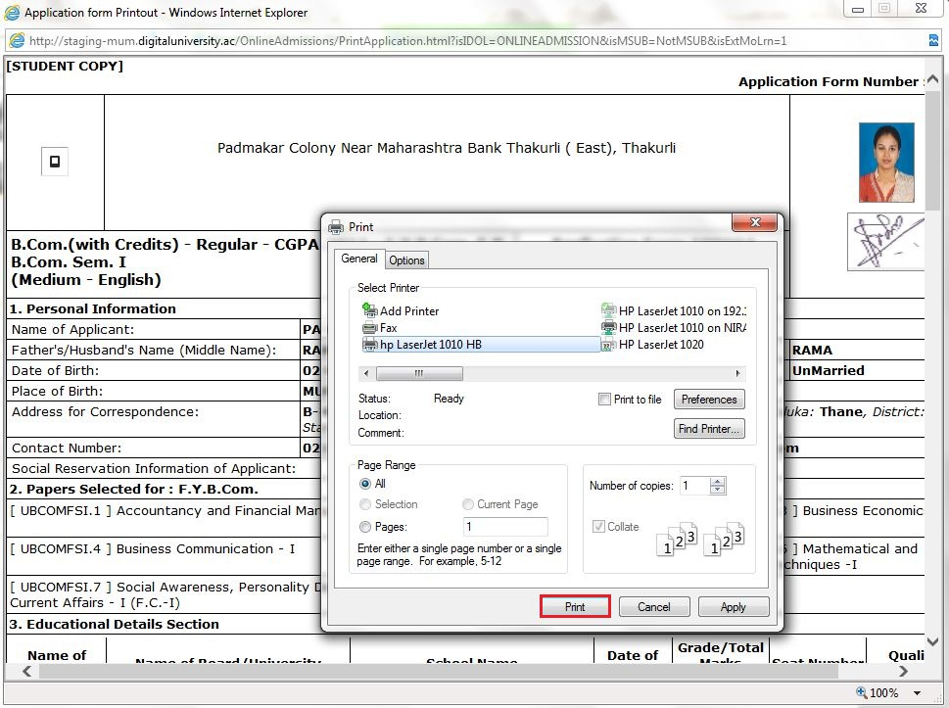
Print Application Form
Click on Print

Slide 55
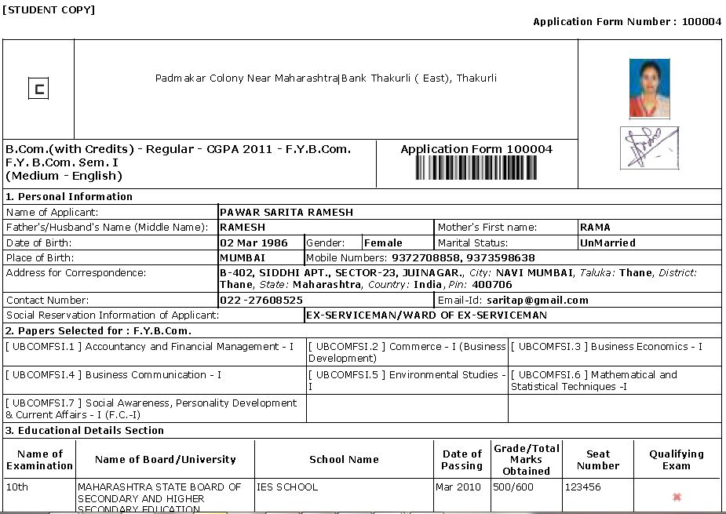
Print Application Form (Student Copy)

Slide 56
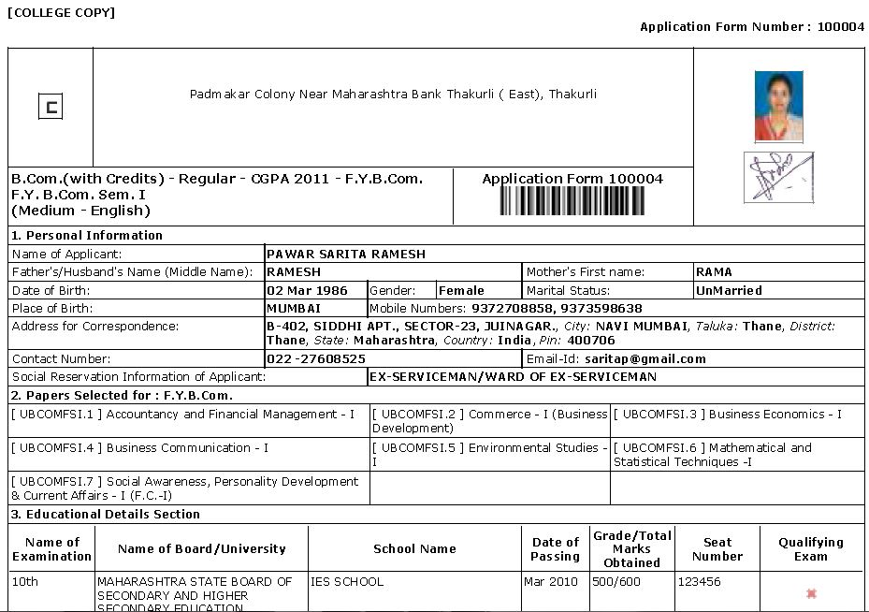
Print Application Form (College Copy)

Slide 57
Application Status
Click on Application Status

Slide 58
Application Current Status

Slide 59
Multi Course Multi College Selection Option

Slide 60
Application Status After College Form Submitted

Slide 61
Application Status After College Admission Confirmed

Slide 62
Online Application Process Completed

