Slide 1
How to take the
Univariety Career Test?
A Step by Step Guide

Slide 2
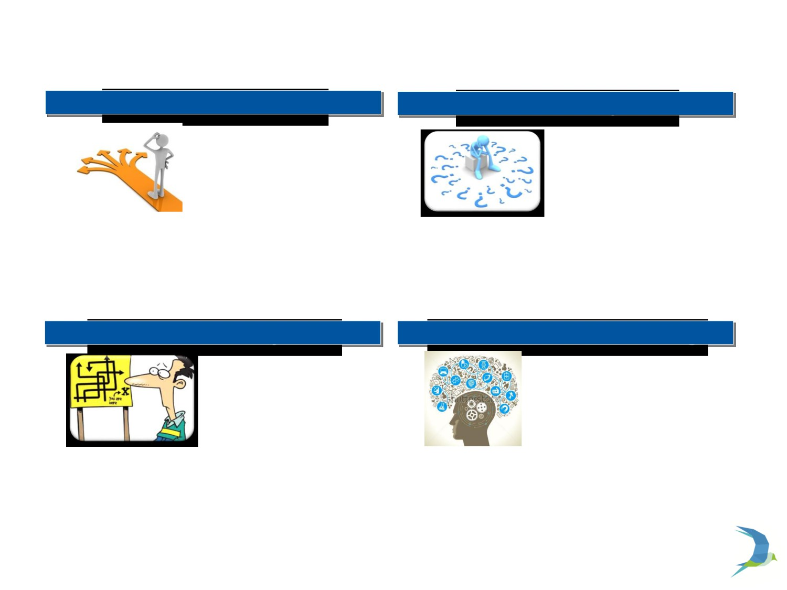
Most Senior School Students Are Not Sure About
Their Career Choices
Confused About Careers
Not Sure About Aptitude
○ Many students have
○ Many students are not sure about different
made career choices
without fully
career options available to them
understanding their core aptitude and strengths
○ Students in most cases don’t understand the link between different careers and the subjects they
○ In many cases students have little idea about which areas they are naturally strong in
need to pursue in school
○ At times students are not even conscious of the fact that they need to start thinking about careers
○ Students sometimes find it difficult to articulate and express their areas of interest and aptitude
Don’t Have Necessary Tools
Un Structured Decision Making
○ There are very few tools available to
○ In absence of robust understanding of
students using which they can identify their areas of strength and weakness
students’ personalities and interests sub optimal decisions on career
choices are made
○ Students at times rely on anecdotal evidence shared by parents or batch mates about their
○ Career decisions currently taken by students follow precedents and herd mentality and in most cases
areas of strength to make an assessment ○ There is a need for a comprehensive and unbiased
do not take into account uniqueness of each student
assessment of all aspects of students’ personalities
○ A more structured and scientific measure needs to be put in place to asses students’ strengths and
1
personalities

Slide 3
Stream Selector Test is an Invaluable Tool Which Can Help Students in Career Selection
What is Psychometric Test?
Personality and Aptitude Assessment
Multiple choice questions
How Does It Help?
Initiate Career Discussion
Points to Remember
It is a tool not a decision maker
Directly related to student’s honesty
Psychological profiling
Honestly ∝ Accuracy
Sense of direction
Scientific approach to decision making
Should have an open mind when reading and analyzing
As it involves human understanding there is always a margin of error involved.

Slide 4
Univariety Test Mechanics | Test Credibility
Online career assessment test | Powered by MERACAREERGUIDE’s (MCG)
7 sections with around 20 questions | National skill development corporation for innovation in career counselling
30-45 minutes | Taken by more than 50,000 students over the last 5 years
Detailed report with a nominal payment | Have been filtered through 11 tests

Slide 5
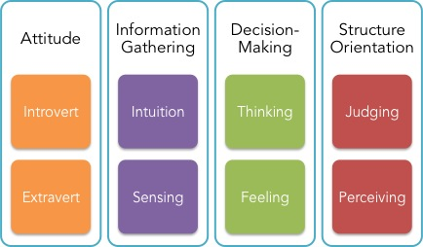
MBTI – Personality Types
I
I
T
J
E
S
F
P

Slide 6
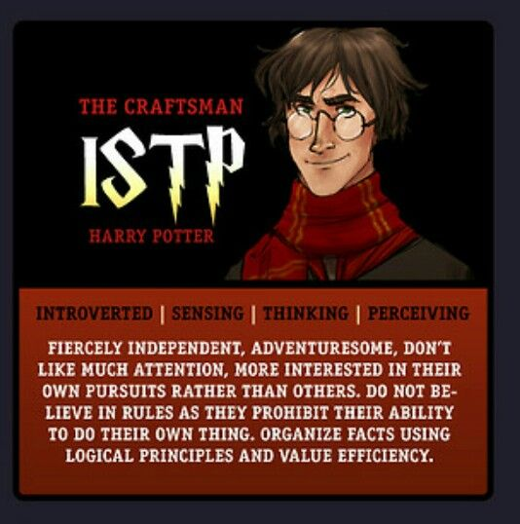
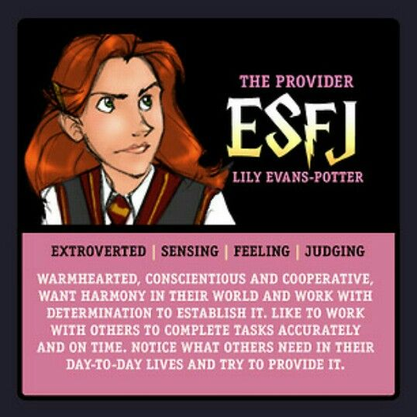

Slide 7
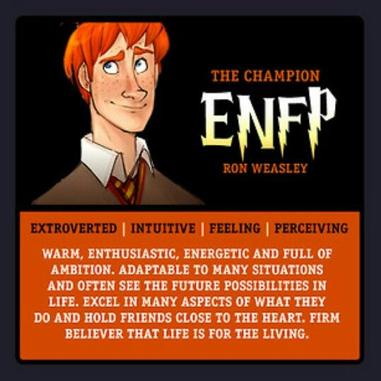
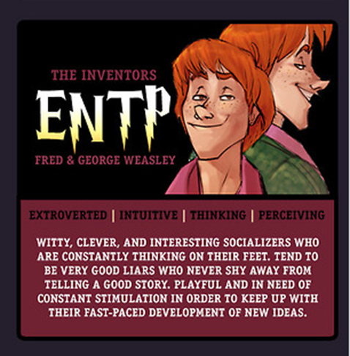

Slide 8
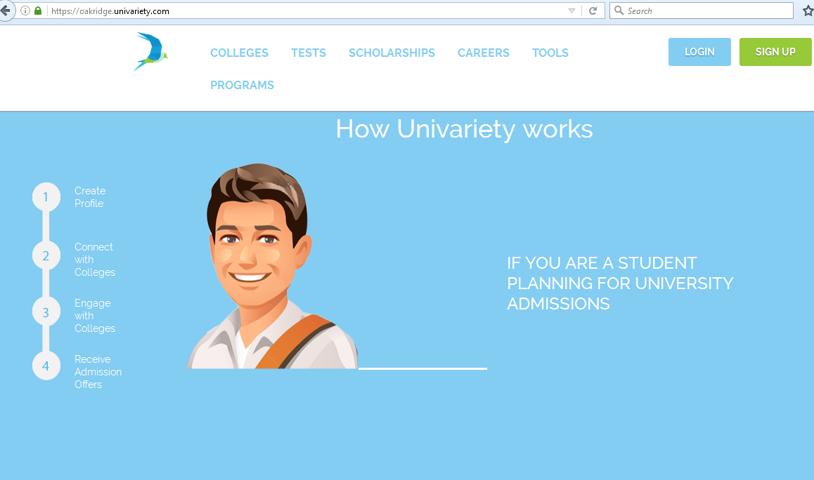
Step 1
Logon to Univariety through your School URL
LOGIN to your Account
or
SIGNUP to create an account on the Univariety first

Slide 9
Step 2
You can login directly if you
have a Univariety profile
You can also sign up and create your profile here before you can start
3

Slide 10
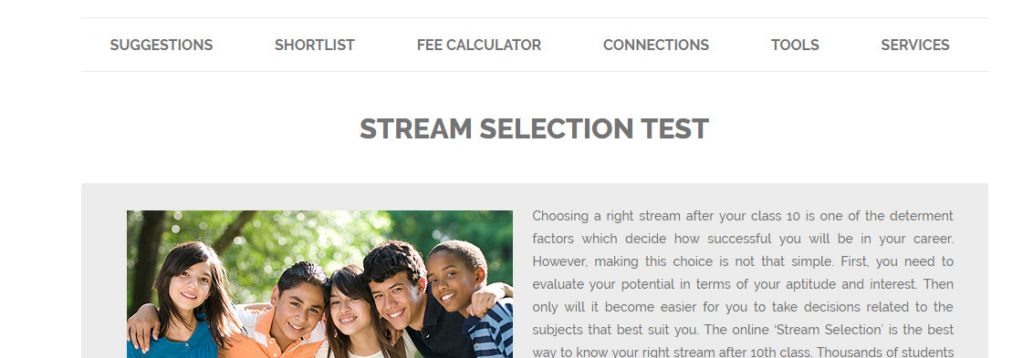
Univariety Stream Selector Can Easily be taken
Test
Student Logins & Starts the
Rupees 999
5

Slide 11
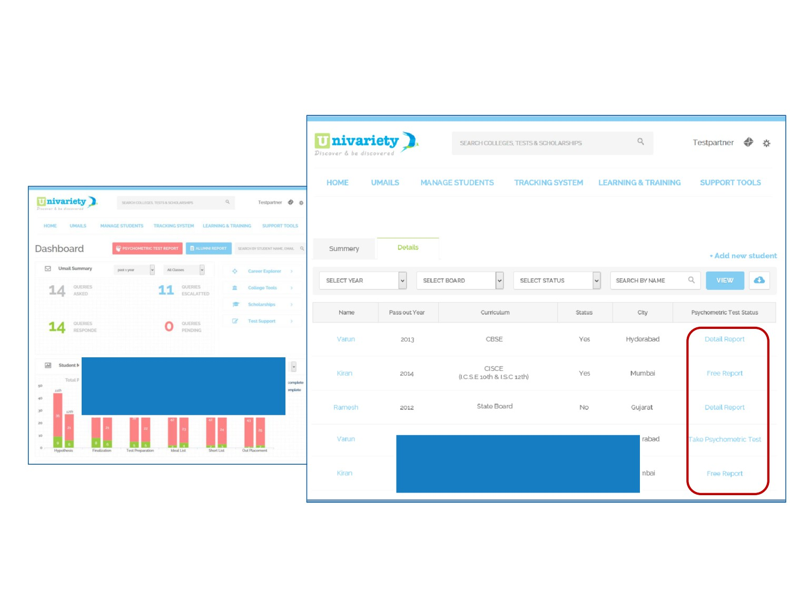
School Teachers and Counsellors Can Access the
Report on Their Dashboards
Reports For The Whole
Batch Will be Accessible Through the Dashboard
Free or Detailed Report Can be Downloaded at a Click of a
Button
6

Slide 12
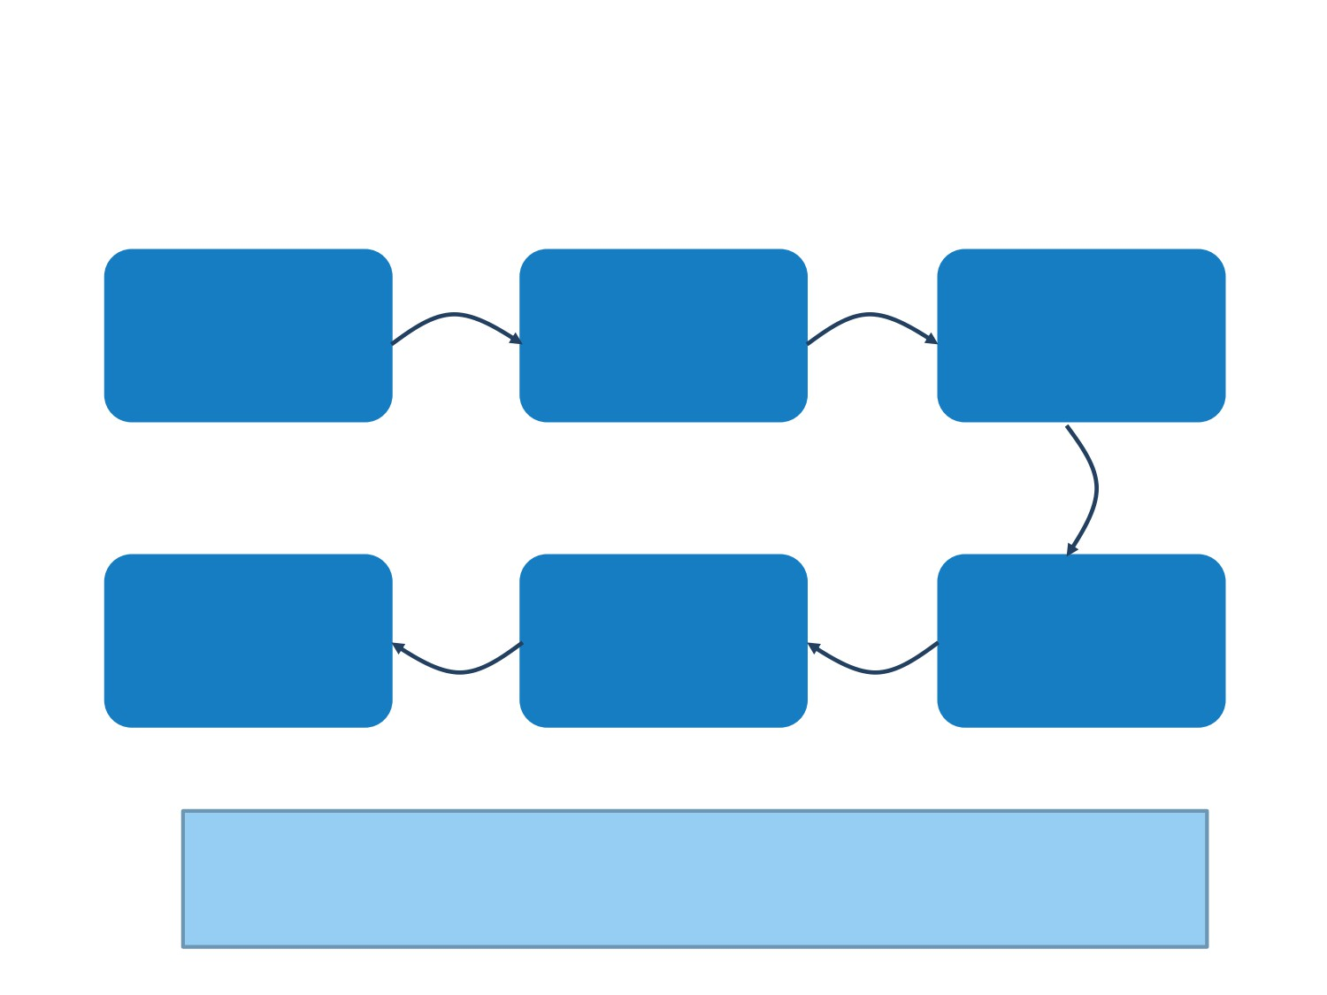
Engaging Univariety for Stream Selector is a fairly
straight forward process
School management decides on the
A payment is made to Univariety for the
School management decides to launch the
number of students
number of students taking the test
test
who will take the test
Test results are
Using the unique
Univariety creates a
generated after payment of a small fee. Students and counsellors can view
school link and the codes students take
unique school links
and gives school unique Codes to be
the results on their Dashboards
the test
given to students
To Ask Any Follow-up Question Please mail us at Schools@univariety.com
7

Slide 13
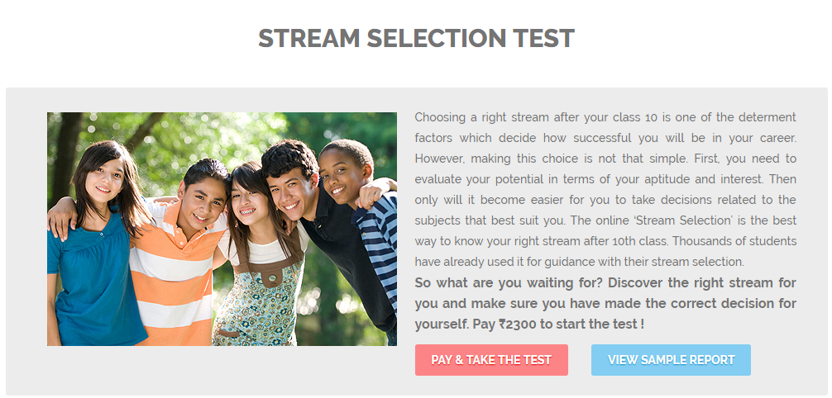
Step 4
3

Slide 14
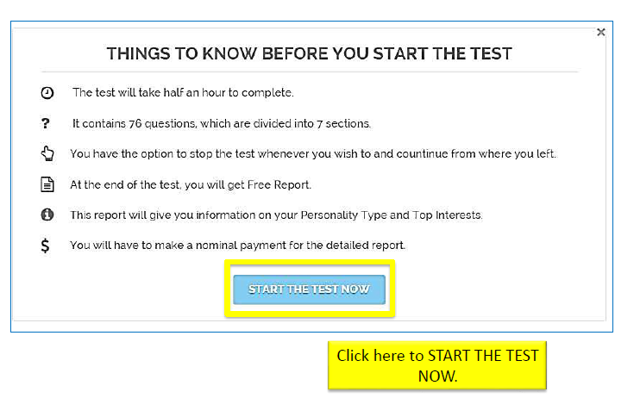
Step 5
3

Slide 15
Step 6
Start answering
truthfully
3

Slide 16
Thank You

